Slide 1
Final Books of the Elements
Euclid
Journey Through Genius Pp 75
Notes:
Final Books of the Elements:
Book VII though IX Euclid proved 102 propositions about whole numbers
Then, in the longest and most sophisticated of all the books with 115 propositions, Book X, Euclid takes a turn and discussed incommensurable magnitudes, in modern times this is referred to expressions involving square roots of real numbers
Prop X.96: **insert here** // discuss the meaning**
Books XI through XIII are concerned with solids or three dimensional geometry
The eleventh book has 39 propositions involving the solid geometry of intersecting planes, plane angles and so on
One of the major results, Prop XI.21: involving a solid angle, for example the apex of a pyramid, formed by three or more plane angles at a meeting point, Euclid proved that the sum of the plane angles at this point is less than four right angles
Book XI dealt with elementary propositions about solid geometry
Book XII dove deeper into the geometry of solids
For example Prop XII.10 looked at Eudoxus’ method of exhaustion to address issues such as the volume of a cone
Prop XII.10: Any cone is a third part of the cylinder which has the same base with its equal height, many years later Archimedes would attribute this proposition to Eudoxus
Surprisingly Prop XII.2 (another great result) involves a plane circle, “Circles are to one another as the squares on their diameters” // This result is touched on by Hippocrates, this is comparing areas and diameters of two circles, not determining an area from a given diameter // A1/D1^2 = A2/D2^2
The ratio of the circles area to the square of its diameter is constant, although Euclid did not tough on the numerical value of this constant, although I am sure we can assume…..
The last proposition of Book XII is the three dimensional equivalent, “spheres are to one another in triplicate ratio of their respective diameters”
The Final Book involves 18 propositions of “regular solids”
To the Greeks, the regular solids represented the epitome of beauty and symmetry
Five solids were known: tetrahedron (pyramid with an equilateral triangle at each of its four faces), the cube, the octahedron (equilateral triangles at each of its eight faces), dodecahedron (regular pentagons at each of its twelve faces), icosahedron (a 20-faced solid with equilateral triangles as faces)
These were also featured in Plato’s Timaeus, around 350 BC, he considered each of the four elements -- fire, water, air, earth -- these could only have been created out of perfect bodies, so it seemed clear to Plato that each element was one of the regular solids
The final proposition, Euclid proved that there can be no more regular solids other than the five listed above, this proof is sophisticated in nature and relies on Prop XI.21
**open the book and read the explanation here, Pp 80** great discussion!!
And with this discussion, the Elements come to an end. Truly a test of time for Euclid, still a modern day marvel.

Slide 2
Book VII through IX Euclid proved 102 propositions about whole number.
Prop X.96: if an area be contained by a rational straight line and a sixth apotome, the side of the area is a straight line which produces with a medial area a medial whole
**an example of his work in this chapter, many of these propositions seem obsolete due to the rational and irrational number systems
In Book X alone he proves 115 propositions regarding incommensurable magnitudes.

Slide 3
Book XI through Book XIII
These books are concerned with solids or three dimensional geometry
The eleventh book has 39 propositions about solid geometry of intersecting planes, plane angles and so on
A major result: Prop XI.21: a solid angle, produced by three or more plane angles, the sum of the plane angles at this point is less than four right angles

Slide 4
Book XI through XIII
Book XII dove deeper into geometry of solids
Major Result: Prop XII.10: Any cone is a third part of the cylinder which has the same base with its equal height
Prop XII.2: Circles are to one another as the squares on their diameters (we saw that Hippocrates knew this as well)
Final Prop XII: spheres are to one another in triplicate ratio of their respective diameters

Slide 5
Book XI through XIII
The Final Book involves 18 propositions of “regular solids”
The Greeks thought regular solids represented the epitome of beauty and symmetry
Five solids were known: tetrahedron, cube, octahedron, dodecahedron, icosahedron
These appeared in Plato’s Timaeus around 350 BC, Plato thought each element -- fire, water, air, earth -- must have been created by perfect bodies, so each was one of the regular solids
Euclid proved there can be no more than the five regular solids mentioned above

Slide 6
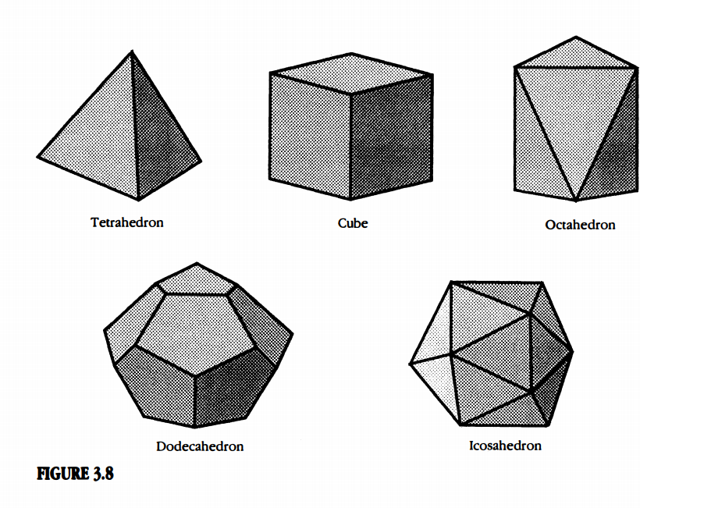
The five regular solids.

Slide 7
Discussion:
Why can there only be five regular solids?
Examine solids with triangles as the faces
With squares as the faces
With pentagons as the faces
The final result: Prop XI.21

Slide 8
Thus ends our journey through Euclid’s Elements

